Slide 1
Festman Electronic Sales Performance
by:
Olusola Timothy Ogundepo

Slide 2
About FestMan Electronic
FestMan Electronics is a multinational electronics company headquartered in Silicon Valley, California. Established in 1985, the company has grown to become a leader in the consumer electronics industry, known for its innovative and cutting-edge products that seamlessly integrate technology into people's lives.
FestMan Electronics has a diverse portfolio of products ranging from smartphones, laptops, and tablets to smart home devices, wearables, and audio equipment. The company's commitment to design excellence and superior quality has earned it a loyal customer base worldwide.

Slide 3
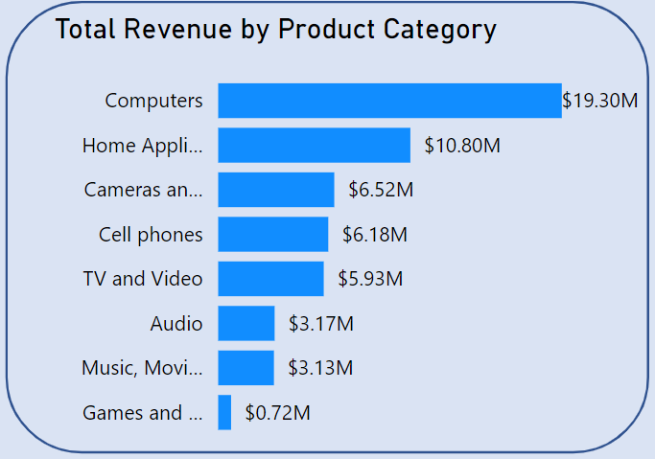
Global Sales Performance
Product Category:
The Computers category leads with $19.3M in revenue and $11.3M in profit, reflecting strong demand and high profitability. Home Appliances follow, generating $10.8M in revenue and $6.3M in profit, indicating solid consumer interest in home tech. Cameras and Camcorders earned $6.52M in revenue with $3.92M in profit, showing steady market interest. Cell Phones brought in $6.18M in revenue and $3.5M in profit, maintaining a competitive presence. Lastly, TV and Video contributed $5.93M in revenue and $3.54M in profit, highlighting the growing demand for home entertainment.

Slide 4
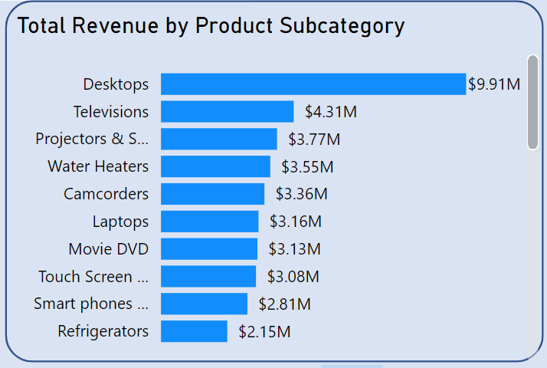
Global Sales Performance
Product Sub-category:
The top 5 subcategories by revenue highlight a strong preference for tech and home products. Desktops lead significantly with $9.91M, followed by Televisions at $4.31M, showing high demand in computing and entertainment. Projectors & Screens earned $3.77M, reflecting their relevance in media presentations, while Water Heaters and Camcorders generated $3.55M and $3.36M respectively, underscoring the steady need for home utilities and niche video recording devices.

Slide 5
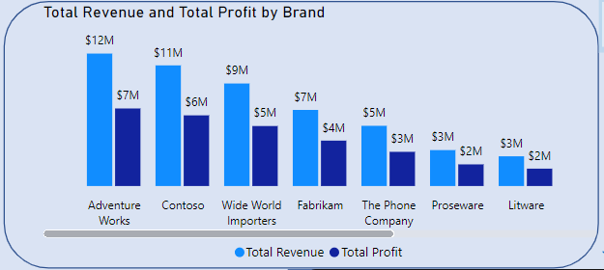
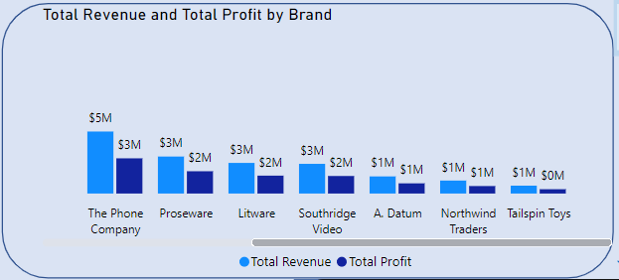
Global Sales Performance
Brand with the highest and Lowest Revenue
Adventure Works emerged as the top-performing brand, achieving a remarkable revenue of $12M and a profit of $7M. This success is largely attributed to its strong presence in high-demand categories such as computers, TV & video, and home appliances. On the other hand, Tailspin Toys recorded the lowest financial performance, with a revenue of $683K and a profit of $373K, focusing exclusively on games and toys.

Slide 6
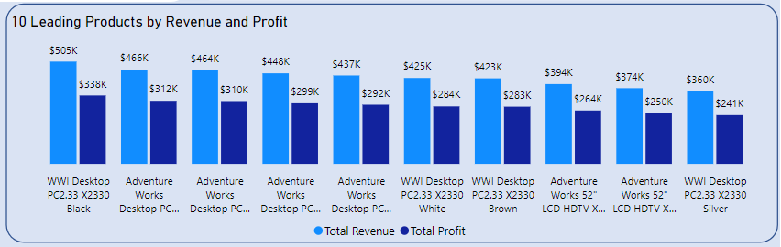
Global Sales Performance
Top Selling and Underperformed Products Sales
The WWI Desktop PC2.33 X2330 Black stands out as the top-performing product in Festman’s sales history, generating a total revenue of $505,000 and a profit of $338,000. In stark contrast, the SV USB Data Cable E600 Silver has the lowest financial performance, with a revenue of $15.20 and a profit of $7.52.

Slide 7
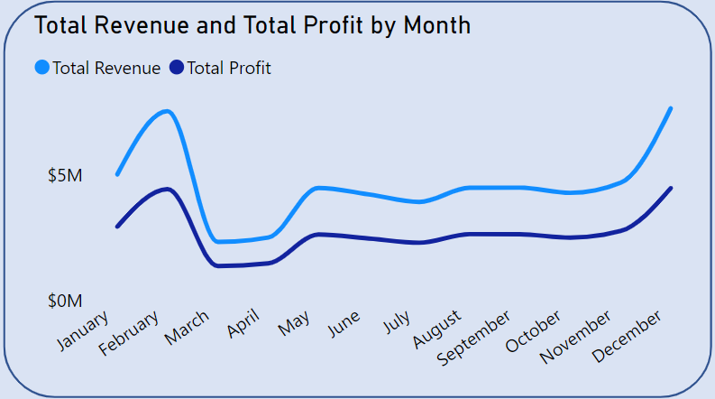
Global Sales Performance
Seasonal Pattern
An analysis of Festman’s sales records over several years reveals a distinct seasonal pattern. Sales and profits consistently rise in January and February each year, followed by a significant decline in March and April. This rise and fall pattern is also observed in various other months throughout the years, indicating cyclical trends in consumer behavior.

Slide 8

Global Sales Performance
Average order value (AOV) for online vs. in-store sales
The analysis of average order values (AOV) reveals a slight difference between online and in-store sales. The AOV for In-store sales is $892.04, whereas the AOV for Online sales is $866.26. This indicates a rate difference of 2.98%, with In-store sales having a marginally higher average order value compared to online sales.

Slide 9
Recommendations
Enhance Marketing for High-Performing Categories
Increase marketing efforts and promotional campaigns for Computers, Home Appliances, and TV & Video to capitalise on their strong performance and further boost sales.

Slide 10
Recommendations
Expand Product Range in Top Subcategories
Consider expanding the product range within the Desktops, Televisions, and Projectors & Screens subcategories to capture more market share in these high-demand areas.

Slide 11
Recommendations
Reevaluate Strategy for Low-Performing Brands
For brands like Tailspin Toys, evaluate the feasibility of continuing their product lines or explore opportunities for diversification to improve financial performance.

Slide 12
Recommendations
Focus on High-Growth Potential Products
Prioritise inventory and promotional support for top-selling products like the WWI Desktop PC while reassessing the viability of underperforming products like the SV USB Data Cable.

Slide 13
Recommendations
Leverage Seasonal Trends
Develop targeted marketing strategies that align with the identified seasonal peaks in January and February to maximise sales. Consider offering special promotions during these months to capitalise on heightened consumer spending.

Slide 14
Recommendations
Boost Online Sales with Targeted Strategies
To close the gap in AOV between Online and In-Store sales, consider implementing targeted online promotions, bundling offers, or loyalty programs that encourage higher spending per transaction.

